Slide 1
MongoDB Project
TV Shows and Movies Database
Notes:
Are your classroom colors different than what you see in this template? That’s OK! Click on Design -> Variants (the down arrow) -> Pick the color scheme that works for you!
Feel free to change any “You will…” and “I will…” statements to ensure they align with your classroom procedures and rules!

Slide 2
Introduction - What Does NOSQL mean?
database Types :
Relational Databases
Non-Relational Databases
Common Mistake : No SQL
NOSQL Stands For : not only SQL
Possible to use SQL *not Common*
Don’t use columns or tables

Slide 3
NOSQL & BIG DATA
NOSQL is usually used for Big Data & real time web applications
BIG DATA ?
Where to find?
Challenges ?
Notes:
Big data describes data sets that are so large that traditional methods of storage and processing are inadequate
where to find : 1- Social media [ FB, Twitter ]
2- Search Engines [ Google ]
Challenges : storage , capture , analysis, transfer , .. etc

Slide 4
Advantages of NOSQL over RDBMS
Handles Big Data
Data Models , No predefined Schemes
Data Structure
Scaling ( Scale out, Horizontal Scaling)
Notes:
It’s good to clarify that RDBS is as important as NOSQL but here’s few advantages are worth to be mentioned
1- handles big data : does it very Quickly
2- Data models : no predefined Schemas
3- data structure : nosql handles unstructured data which means it is cheaper to manage
4- Scaling : it is the opposite of RDB using Scale up , vertical Scaling

Slide 5
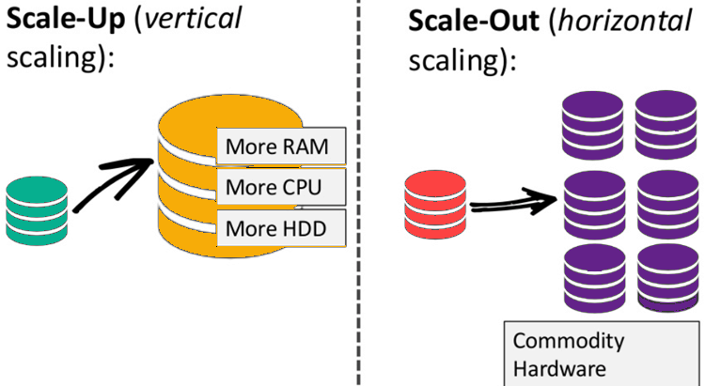
Notes:
example that explains scaling mentioned in previous slide

Slide 6
Advantages of RDBMS over NOSQL
Better for relational data
Normalization
Better performance
Very Solid & Easy to learn
Data Integrity
ACID Compliance
Notes:
Normalization organize data in away that eliminate redundancy it allows database to take up as a little space as possible
Very solid because it’s a bit old language but still it’s easy to learn
ACID : Atomicity , consistency, integrability , Durability

Slide 7
Types of NOSQL Databases
Document-based Store Database
MongoDB , CouchDB
Column- based Database
Apache cassandra
Key value-Store Database
Riak
Graph-based
Neo4J

Slide 8
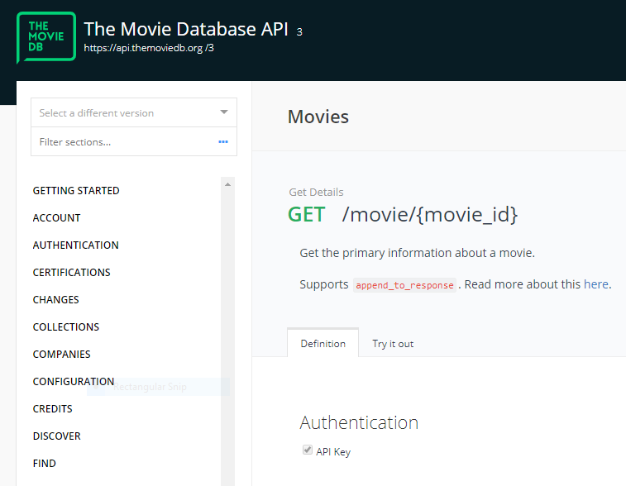
Fetching Data
Movies were fetched using The Movie DB API (TMDB)
Shows were fetched using TVMaze API

Slide 9
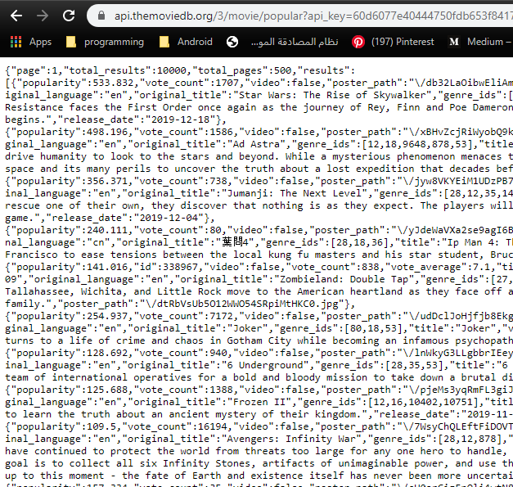
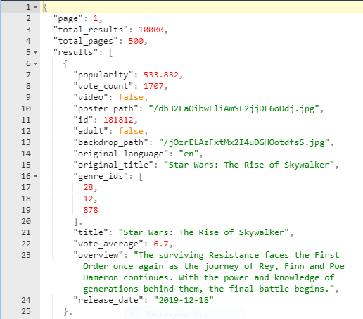
API Response Data
Formatted Data

Slide 10
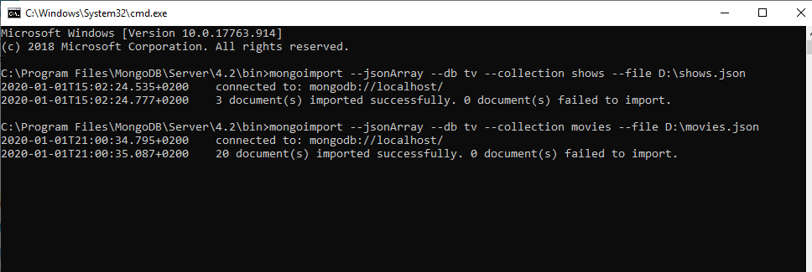
Importing Datasets into MongoDB

Slide 11
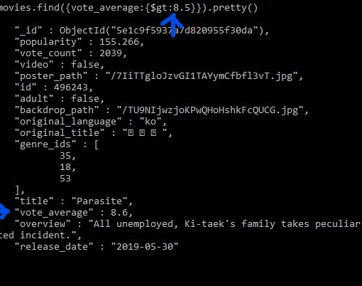
Database Queries
1- Selection:
db.mycol.find();
db.mycol.find().pretty();
db.mycol.find({“key":“value/ condition"}).pretty();

Slide 12
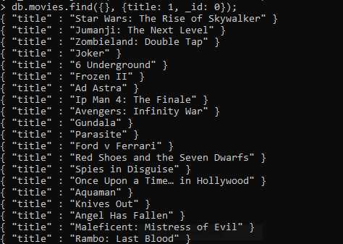
2- Projection:
db.COLLECTION_NAME.find({}, {KEY1: 1, KEY2: 1})
KEY: 1 -> Show KEY
KEY: 0 -> Hide KEY

Slide 13
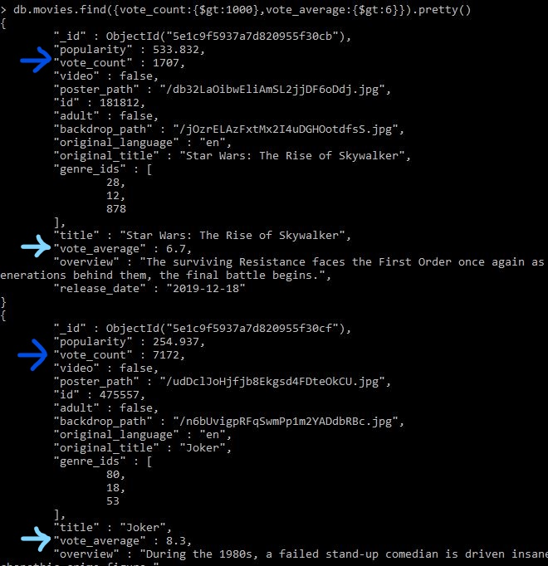
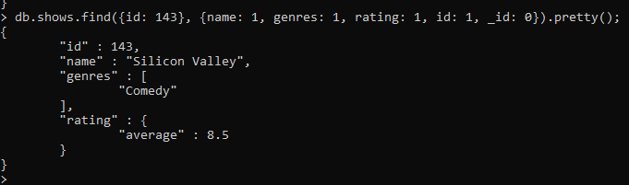

vote_count > 1000 AND vote_average > 6
view the id, name, genres and rating of
TV show of id 143
view the id, name and sort TV shows
according to their id

Slide 14
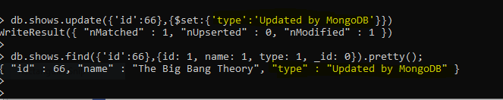
3- Update Document(s):
db.COLLECTION_NAME.update(SELECTION_CRITERIA, UPDATED_DATA)

Slide 15
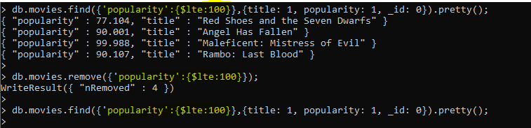
4- Delete Document(s):
db.COLLECTION_NAME.remove(DELLETION_CRITTERIA)
db.COLLECTION_NAME.remove() -> Deletes all documents in a collection

Slide 16
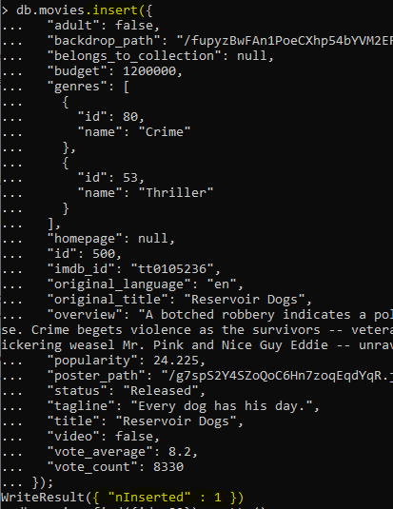

5- Insert Document(s):
db.categories.insert({DOCUMENT})
6- Delete a collection/database:
db. COLLECTION_NAME.drop()
db.dropDatabase()

Slide 17
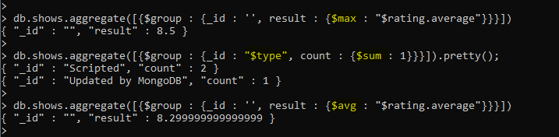
Aggregation
db.COLLECTION_NAME.aggregate(AGGREGATE_OPERATION)
Such as: $sum, $avg, $max, $min, ..etc

